Slide 1
Chapter One
Introduction to Artificial Intelligence

Slide 2
Outlines
Introduction to AI
Objectives/Goals of AI
What is AI?
Approaches to AI – making computer:
Think like a human ( Thinking humanly)
Act like a human (Acting humanly)
Think rationally (Thinking rationally)
Act rationally (Acting rationally)
The Foundations of AI
Bits of History and the State of the Art

Slide 3
Introduction
We call ourselves Homo sapiens—man the wise—because our intelligence is so important to us.
For thousands of years, we have tried to understand how we think; that is, how a mere handful of matter can perceive, understand, predict, and manipulate a world far larger and more complicated than itself.
The field of artificial intelligence, or AI, goes further still: it attempts not just to understand but also to build intelligent entities.

Slide 4
Cont’d…
AI currently encompasses a huge variety of subfields, ranging from the general (learning and perception) to the specific, such as playing chess, proving mathematical theorems, writing poetry, driving a car on a crowded street, and diagnosing diseases.
AI is relevant to any intellectual task; it is truly a universal field.

Slide 5
Basic Concepts
There are eight definitions of AI, laid out along two dimensions.
The definitions on top are concerned with thought processes and reasoning, whereas the ones on the bottom address behavior.
The definitions on the left measure success in terms of fidelity to human performance, whereas the ones on the right measure against an ideal performance measure, called rationality.
A system is rational if it does the “right thing,” given what it knows

Slide 6
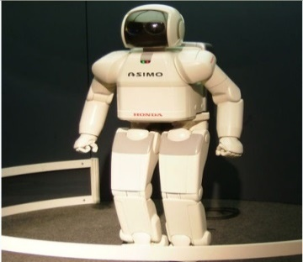
What is AI?
Artificial Intelligence (AI) is usually defined as the science of making computers do things that require intelligence when done by humans.
AI has had some success in limited, or simplified, domains.
However, the five decades since the inception of AI have brought only very slow progress, and early optimism concerning the attainment of human-level intelligence has given way to an appreciation of the profound difficulty of the problem.
The term AI is first used by John McCarthy (1956) who considers it to mean the science and engineering of making intelligent machine.

Slide 7
What is Intelligence
Intelligence is a general mental capability that involves the ability to reason, plan, solve problems, think abstractly, comprehend ideas and language, and learn.
Quite simple human behavior can be intelligent yet quite complex behavior performed by insects is unintelligent.
What is the difference? Consider the behavior of the digger wasp, Sphex ichneumoneus.
When the female wasp brings food to her burrow, she deposits it on the threshold, goes inside the burrow to check for intruders, and then if the coast is clear carries in the food.

Slide 8
The unintelligent nature of the wasp's behavior is revealed if the watching experimenter moves the food a few inches while the wasp is inside the burrow checking. On emerging, the wasp repeats the whole procedure: she carries the food to the threshold once again, goes in to look around, and emerges. She can be made to repeat this cycle of behavior upwards of forty times in succession.
Intelligence--conspicuously absent in the case of Sphex--is the ability to adapt one's behavior to fit new circumstances.
Mainstream thinking in psychology regards human intelligence not as a single ability or cognitive process but rather as an array of separate components.
Research in AI has focused chiefly on the following components of intelligence: learning, reasoning, problem-solving, perception, and language-understanding.

Slide 9
Learning
Learning is distinguished into a number of different forms.
The simplest is learning by trial-and-error.
For example, a simple program for solving mate-in-one chess problems might try out moves at random until one is found that achieves mate.
The program remembers the successful move and next time the computer is given the same problem it is able to produce the answer immediately. The simple memorizing of individual items--solutions to problems, words of vocabulary, etc.--is known as rote learning.
Rote learning is relatively easy to implement on a computer. More challenging is the problem of implementing what is called generalization.

Slide 10
Learning that involves generalization leaves the learner able to perform better in situations not previously encountered.
A program that learns past tenses of regular English verbs by rote will not be able to produce the past tense of e.g. "jump" until presented at least once with "jumped", whereas a program that is able to generalize from examples can learn the "add-ed" rule, and so form the past tense of "jump" in the absence of any previous encounter with this verb.
Sophisticated modern techniques enable programs to generalize complex rules from data.

Slide 11
Reasoning
To reason is to draw inferences appropriate to the situation in hand. Inferences are classified as either deductive or inductive.
Deductive: "Fred is either in the museum or the cafe; he isn't in the cafe; so he's in the museum",
Inductive: "Previous accidents just like this one have been caused by instrument failure; so probably this one was caused by instrument failure".
The difference between the two is that in the deductive case, the truth of the premises guarantees the truth of the conclusion, whereas in the inductive case, the truth of the premises lends support to the conclusion that the accident was caused by instrument failure, but nevertheless further investigation might reveal that, despite the truth of the premises, the conclusion is in fact false.
There has been considerable success in programming computers to draw inferences, especially deductive inferences.
Reasoning involves drawing inferences that are relevant to the task or situation in hand.

Slide 12
Problem-solving
Problems have the general form: given such-and-such data, find x. A huge variety of types of problem is addressed in AI.
Some examples are: finding winning moves in board games; identifying people from their photographs; and planning series of movements that enable a robot to carry out a given task.
Problem-solving methods divide into special-purpose and general-purpose.
A special-purpose method is tailor-made for a particular problem, and often exploits very specific features of the situation in which the problem is embedded.
A general-purpose method is applicable to a wide range of different problems.
One general-purpose technique used in AI is means-end analysis, which involves the step-by-step reduction of the difference between the current state and the goal state.
The program selects actions from a list of means--which in the case of, say, a simple robot, might consist of pickup, putdown, moveforward, moveback, moveleft, and moveright--until the current state is transformed into the goal state.

Slide 13
Perception
In perception the environment is scanned by means of various sense-organs, real or artificial, and processes internal to the perceiver analyze the scene into objects and their features and relationships.
Analysis is complicated by the fact that one and the same object may present many different appearances on different occasions, depending on the angle from which it is viewed, whether or not parts of it are projecting shadows, and so forth.
At present, artificial perception is sufficiently well advanced to enable a self-controlled car-like device to drive at moderate speeds on the open road, and a mobile robot to roam through a suite of busy offices searching for and clearing away empty soda cans.

Slide 14
Language-understanding
A language is a system of signs having meaning by convention. Traffic signs, for example, form a mini-language, it being a matter of convention that, for example, the hazard-ahead sign means hazard ahead.
This meaning-by-convention that is distinctive of language is very different from what is called natural meaning, exemplified in statements like 'Those clouds mean rain' and 'The fall in pressure means the valve is malfunctioning'.
An important characteristic of full-fledged human languages, such as English, which distinguishes them from, e.g. bird calls and systems of traffic signs, is their productivity.
A productive language is one that is rich enough to enable an unlimited number of different sentences to be formulated within it.
It is relatively easy to write computer programs that are able, in severely restricted contexts, to respond in English, seemingly fluently, to questions and statements, for example the Parry and Shrdlu programs described in the section Early AI Programs. However, neither Parry nor Shrdlu actually understands language.

Slide 15
Introduction … Cont’d
AI system possess
Natural language processing to enable it to communicate successfully in human language
Knowledge representation to store what it knows or hears
Automated reasoning to use the stored information to answer questions and to draw new conclusions
Machine learning to adapt to new circumstances and to detect and extrapolate patterns
Computer vision to perceive objects
Robotics to manipulate objects and move about
And others

Slide 16
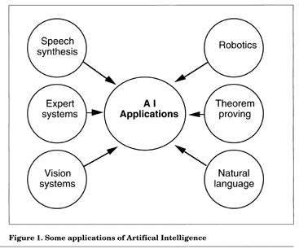
Some Application Areas of AI

Slide 17
Views of defining AI
Different scholars define AI differently
1. Thinking humanly | 2. Acting humanly
3. Thinking rationally | 4. Acting rationally

Slide 18
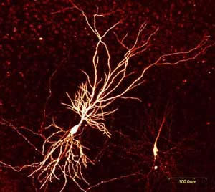
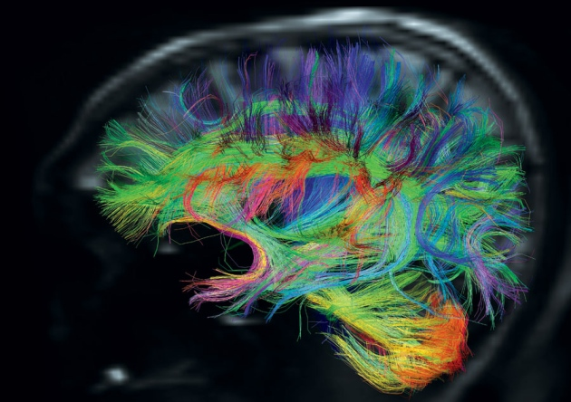
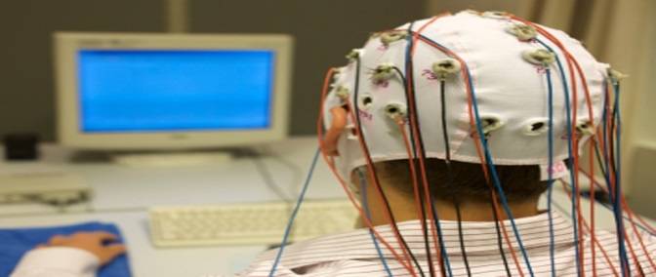
AI definition 1: Thinking humanly
Need to study the brain as an information processing machine: cognitive science and neuroscience
AI as systems that think humanly
“The automation of activities that we associate with human thinking, activities such as decision-making, problem solving, learning …” (Bellman definition, 1978)
“The exciting new effort to make computers think … machines with minds, in the full and literal sense” (Haugeland definition, 1985)

Slide 19
Thinking humanly: cognitive modeling
Can we build a brain?
Requires:
Scientific theories of internal activities of the brain
How human thinks?
How to validate a given agent think humanly?
The answer Requires either
Predicting and testing the behavior of human subjects from his/her thinking point of view (top-down) or
Direct identification from neurological data (bottom-up)
Study on Mental processing logic of human being (cognitive science) is not yet fertile

Slide 20
AI definition 2: Acting humanly
“The art of creating machines that perform functions that require intelligence when performed by people.” (Kurzweil definition, 1990)
“The study of how to make computers do things at which, at the moment, people are better.” (Rich and Knight definition, 1991)

Slide 21
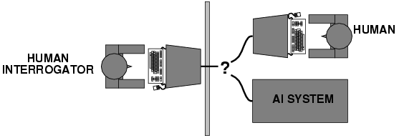
Acting humanly: Turing Test
Turing (1950) on his famous paper "Computing machinery and intelligence":
"Can machines think?" → "Can machines behave intelligently?"
Operational test for intelligent behavior: the Imitation Game
Predicted that by 2000, a machine might have a 30% chance of fooling a person for 5 minutes
Anticipated all major arguments against AI in following 50 years
Active areas of research to achieve this: Machine learning, NLP, Computer vision, etc

Slide 22
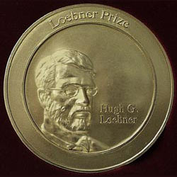
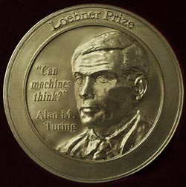
The Turing Test
Loebner prize
2008 competition: each of 12 judges was given five minutes to conduct simultaneous, split-screen conversations with two hidden entities (human and chatterbot). The winner, Elbot of Artificial Solutions, managed to fool three of the judges into believing it was human [Wikipedia].

Slide 23
AI definition 3: Thinking rationally
A system is said to be rational if it does the “right thing” given what it knows.
“The study of mental faculties through the use of computational models.” (Charniak and McDermott definition, 1985)
“The study of the computations that make it possible to perceive, reason, and act.” (Winston definition, 1992)

Slide 24
Thinking rationally: "laws of thought"
Right thinking is related to irrefutable reasoning process
Require structure that always gave correct conclusion given correct premises
Logic is the key to design and implement an agent that think rationally
Several Greek schools developed various forms of logic: notation and rules of derivation for thoughts;
Direct line through mathematics and philosophy to modern AI
Logic: patterns of argument that always yield correct conclusions when supplied with correct premises
“Socrates is a man; all men are mortal; therefore Socrates is mortal.”

Slide 25
AI definition 3: Thinking rationally
Logicist approach to AI: describe problem in formal logical notation and apply general deduction procedures to solve it
Problems with the logicist approach
Computational complexity of finding the solution
Describing real-world problems and knowledge in logical notation
Dealing with uncertainty
A lot of “rational” behavior has nothing to do with logic

Slide 26
AI definition 4: Acting rationally
“Computational intelligence is the study of the design of intelligent agent” (Poole, et al definition, 1998)
“AI … is concerned with intelligent behavior in artifacts.” (Nilsson definition, 1998)
The course advocates to agents that act rationally

Slide 27
Acting rationally: rational agent
Means acting so as to achieve one’s goals, given one’s beliefs.
In this approach, AI is viewed as the study and construction of rational agent
Rational behavior: doing the right thing
The right thing: is the action/decision which is expected to maximize goal achievement, given the available information
Doesn't necessarily involve thinking
One way of acting rationally is to reason logically to the action.
This indicates, making correct inference is part of being a rational agent
But rationality doesn’t require correct inference because some time without having correct thing to do, agent must act rationally

Slide 28
Utility maximization formulation
Advantages
Generality: goes beyond explicit reasoning, and even human cognition altogether
Practicality: can be adapted to many real-world problems
Naturally accommodates uncertainty
Amenable to good scientific and engineering methodology
Avoids philosophy and psychology
Disadvantages?

Slide 29
Introduction … Cont’d
AI follows all the four approach but tension existing between approaches which are centered around human and rationality.
Human centered approach must be empirical science, involving hypothesis and experimental confirmation.
A rationalist approach involves a combination of mathematics and engineering
This course focus on the study of a rational agent that think and act rationally.

Slide 30
AI prehistory
Philosophy Logic, methods of reasoning, mind as physical system foundations of learning, language, rationality
Mathematics Formal representation and proof algorithms, computation, (un) decidability, (in) tractability, probability
Economics Decision theory
Neuroscience physical substrate for mental activity
Psychology phenomena of perception and motor control, experimental techniques
Computer building fast computers engineering
Control theory design systems that maximize an objective function over time
Linguistics knowledge representation, syntax, grammar

Slide 31
History of AI
Warren McClloch and Walter Pitts (1943)
1st AI work: Boolean circuit model of the brain
Drew on three sources
Knowledge of the basic physiology and function of neurons in the brain
The formal analysis of propositional logic due to Russell and Whitehead
Turing’s theory of computation
They proposed a model of artificial neurons
They showed any computable function could be computed by some network of connected neurons
They also suggested that suitably defined networks could learn

Slide 32
History of AI
Claude Shannon (1950) and Alan Turing (1953)
Write a chess program
Marvin Minisky and Dean Edmonds (1951)
Built the 1st neural network computer

Slide 33
History of AI Cont..
Newell and Simon develop a reasoning program called the Logic Theorist (LT) before Dartmouth workshop
They then come up with the General Problem Solver (GPS)
GPS, unlike LT, is designed to imitate human problem solving protocols and it is the 1st program to embody the “thinking humanly” approach of AI
Herbert Gelernter, 1959 constructed the Geometry Theorem Prover (GTP)

Slide 34
History of AI Cont..
Arthur Samuel, 1952 wrote a series of checker programs
It can learn, which disprove the idea that computer can only do what they are told to do
His program play better than the creator
John Mcarty, 1958 at MIT
Define the 2nd old high level programming language, LISP which is the 1st and dominant AI programming language
Invent time sharing concept with his friend to avoid the problem of time as a resource.

Slide 35
History of AI Cont..
1958 is also marked the year that Marvin Minisky moved to MIT
Minisky supervised a series of students who choose limited problems that appeared to require intelligence to solve (this problems known as Micro world)
The most dominant micro world problem is the block world
It consists of a set of solid blocks placed on top of the table

Slide 36
Summary on history of AI
1943 McCulloch & Pitts: Boolean circuit model of brain
1950 Turing's "Computing Machinery and Intelligence"
1956 Dartmouth meeting: "Artificial Intelligence" adopted
1952—69 Look, Ma, no hands!
1950s Early AI programs, including Samuel's checkers program, Newell & Simon's Logic Theorist, Gelernter's Geometry Engine
1965 Robinson's complete algorithm for logical reasoning
1966—73 AI discovers computational complexity Neural network research almost disappears
1969—79 Early development of knowledge-based systems
1980-- AI becomes an industry
1986-- Neural networks return to popularity
1987-- AI becomes a science
1995-- The emergence of intelligent agents

Slide 37
AI state of the art
What can AI do today?
A concise answer is difficult because there are so many activities in so many subfields.
Robotic vehicles
Speech recognition:
Autonomous planning and scheduling
Game playing
Spam fighting
Logistics planning
Robotics
Machine Translation

Slide 38
Summary
Different people approach AI with different goals in mind. Two important questions to ask are: Are you concerned with thinking or behavior? Do you want to model humans or work from an ideal standard?
Intelligence is concerned mainly with rational action. Ideally, an intelligent agent takes the best possible action in a situation.
We study the problem of building agents that are intelligent in this sense.
The history of AI has had cycles of success, misplaced optimism, and resulting cutbacks in enthusiasm and funding. There have also been cycles of introducing new creative approaches and systematically refining the best ones.

Slide 39
AI has advanced more rapidly in the past decade because of greater use of the scientific method in experimenting with and comparing approaches.
Recent progress in understanding the theoretical basis for intelligence has gone hand in hand with improvements in the capabilities of real systems.
The subfields of AI have become more integrated, and AI has found common ground with other disciplines

Slide 40
Write the four ways in which AI is defined with scenario.
Discuss the challenges and Opportunities of AI? Give example for each.

